Slide 1
Project Loom
Author: Konrad Kowalczyk
Repository: xkondix loom

Slide 2

Presentation Plan
Virtual Threads
Continuation
Virtual Threads Examples
Scoped Value
Structured Concurrency
Virtual Threads + Spring Boot
Virtual Threads vs Completable Future
Questions

Slide 3
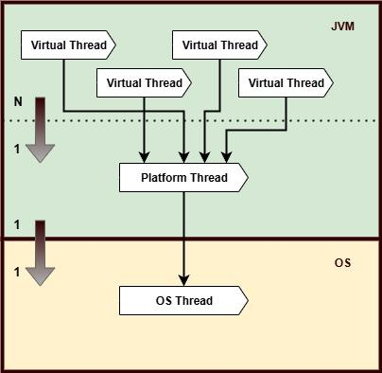
Virtual & Platform & OS Threads
Both Platform and Virtual Threads are managed by the JVM
Platform Threads are heavyweight and have a 1:1 mapping with OS threads
Virtual Threads are lightweight and have an n:1 mapping to Platform Threads
Virtual Threads are ideal for tasks with blocking I/O or high concurrency needs
JVM's scheduler handles Virtual Thread execution by reusing Platform Threads
Blocking a Virtual Thread does not block the OS Thread thanks to continuation-based scheduling

Slide 4
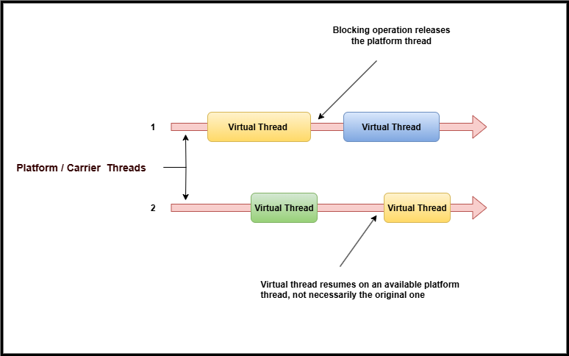
Virtual Thread Scheduler

Slide 5
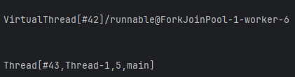
Thread.currentThread()
platform thread
type virtual/platform
unique ID
name
A virtual thread is assigned to a platform thread
While it is assigned, the platform thread is the carrier (or carrier thread) for the virtual thread

Slide 6
Threads managed by the JVM
Platform Thread A traditional Java thread that wraps a native Operating System (OS) thread. It is created and managed by the JVM, but its execution is scheduled by the OS thread scheduler.
Virtual Thread A lightweight thread managed by the JVM's virtual thread scheduler. It can be mounted (bound) to a platform thread for execution when running code. Virtual threads are ideal for highly concurrent, non-blocking tasks.
Carrier Thread A platform thread that temporarily executes a virtual thread’s code during its active phase. While mounted, the platform thread acts as the carrier for the virtual thread.

Slide 7

Continuation
⚠️ Continuation is an internal JDK class that encapsulates code which can be paused and resumed later, and is not intended for public use.
File
→ Settings (or Ctrl+Alt+S)
→ Build, Execution, Deployment
→ Compiler
→ Java Compiler
You need uncheck the release box

Slide 8
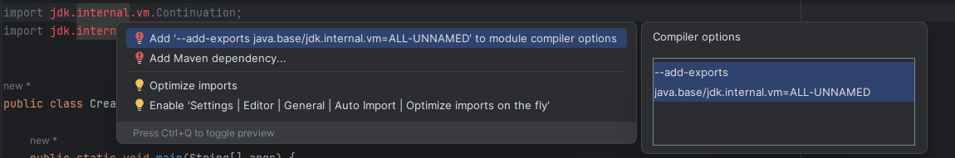
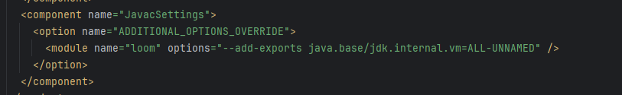
Unlock internal classes IDEA
Click CTRL + ENTER -> ADD import jdk.internal.vm.Continuation;

Slide 9
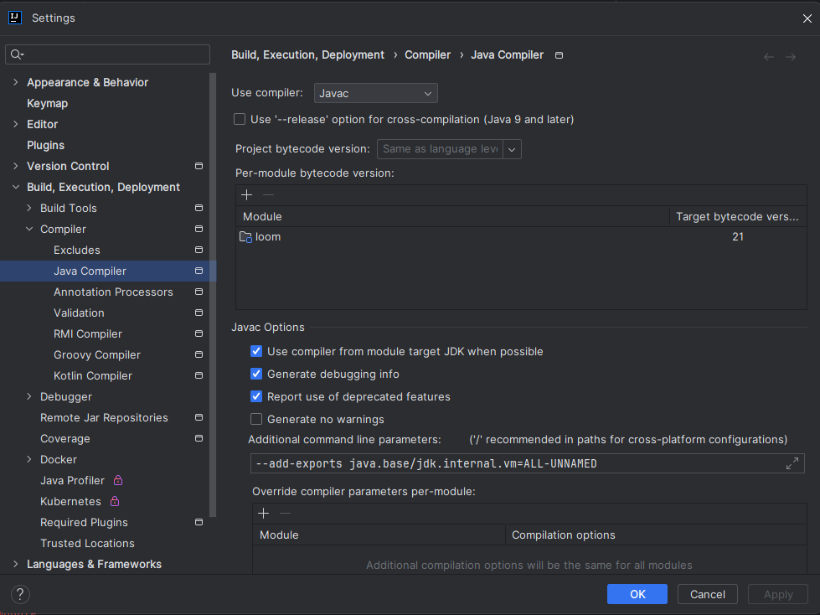
Unlock internal classes Java Compiler
File
→ Settings (or Ctrl+Alt+S)
→ Build, Execution, Deployment
→ Compiler
→ Java Compiler
--enable-preview --add-exports java.base/jdk.internal.vm=ALL-UNNAMED

Slide 10
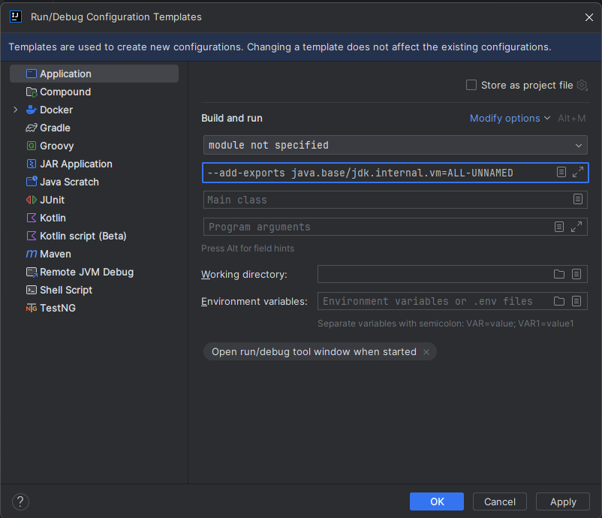
Unlock internal classes VM Options
Steps:
Run → Edit Configurations (from the top menu) → in the bottom-left corner, click Edit configuration templates → select Application → in the VM options field, enter: --enable-preview --add-exports java.base/jdk.internal.vm=ALL-UNNAMED
Click Apply, then OK.

Slide 11
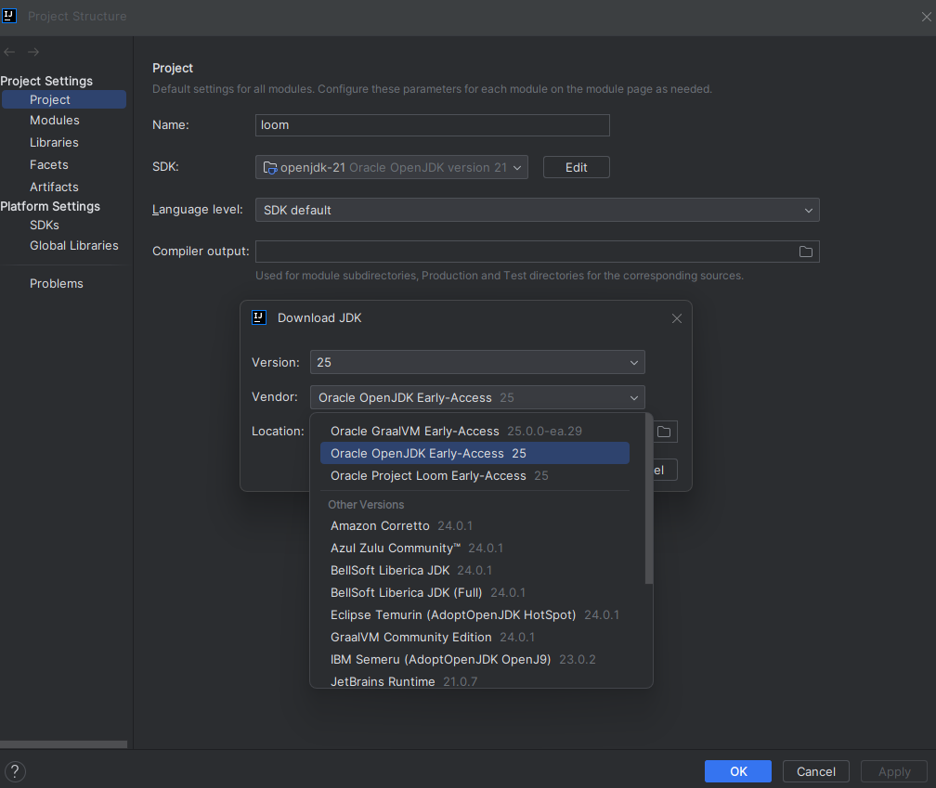
JAVA 25
Option 1
Option 2
https://jdk.java.net./25/

Slide 12
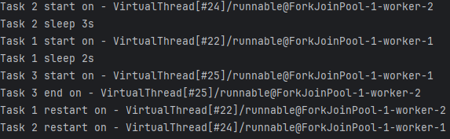
Virtual Thread Scheduler
VM options -Djdk.virtualThreadScheduler.parallelism=2

Slide 13
Pinning
Pinning occurs when the virtual thread does not release the platform thread.
JAVA 21
synchronized blocks ❌
datagram sockets ❌
DNS lookups ❌❔️
native blocking code ❌
file operations ❌ ❔️
JAVA 25
synchronized blocks ✅
datagram sockets ❌❔️
DNS lookups ❌❔️
native blocking code ❌
file operations ❌❔️

Slide 14
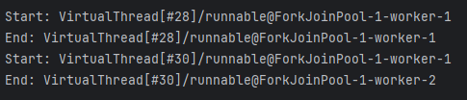
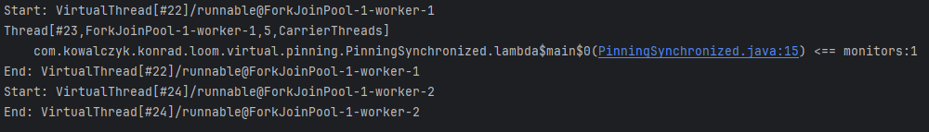
Synchronized blocks
vm options
-Djdk.tracePinnedThreads=short -Djdk.virtualThreadScheduler.parallelism=1
JAVA 25
JAVA 21

Slide 15
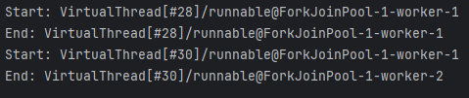
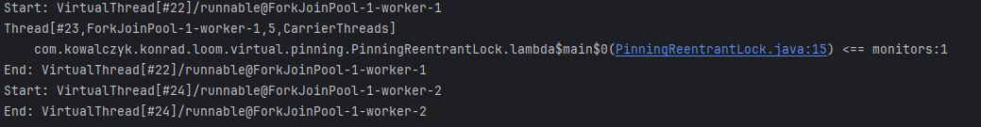
ReentrantLock
vm options
-Djdk.tracePinnedThreads=short -Djdk.virtualThreadScheduler.parallelism=1
JAVA 25
JAVA 21

Slide 16
IO operations
I have not been able to reproduce it, but based on the documentation it is probably possible in both JAVA 21 and JAVA 25.
Nevertheless, many operations are safe in both versions. More in the documentation.
VM options -Djdk.tracePinnedThreads=full
link to doc -> https://openjdk.org/jeps/444#java-io

Slide 17
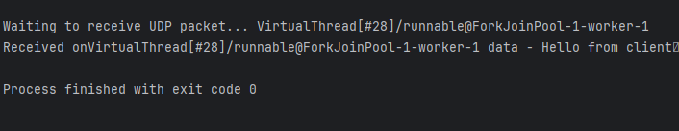

Datagram Socket
VM options -Djdk.tracePinnedThreads=short
JAVA 25
JAVA 21

Slide 18
DNS lookups
I have not been able to reproduce it, but based on the documentation it is probably possible in both JAVA 21 and JAVA 25.
VM options -Djdk.tracePinnedThreads=full
link to doc -> https://openjdk.org/jeps/444#Networking

Slide 19
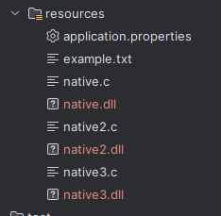

Native blocking code
1. download gcc https://winlibs.com/#download-release
2. add to path bin folder
3. cd .\src\main\resources
4. run:
gcc -I"$env:JAVA_HOME\include" -I"$env:JAVA_HOME\include\win32" -shared -o native.dll native.c
gcc -I"$env:JAVA_HOME\include" -I"$env:JAVA_HOME\include\win32" -shared -o native2.dll native2.c
gcc -I"$env:JAVA_HOME\include" -I"$env:JAVA_HOME\include\win32" -shared -o native3.dll native3.c
5. VM options -Djdk.tracePinnedThreads=full -Djava.library.path=C:\Users\konra\Desktop\loom\src\main\resources
“There are two scenarios in which a virtual thread cannot be unmounted during blocking operations because it is pinned to its carrier:
When it executes code inside a synchronized block or method
When it executes a native method or a foreign function “

Slide 20
Scoped Value
A ScopedValue is a new way in Java to safely share immutable data across methods and threads, without using thread-local variables.
It allows you to:
Bind a value to a limited dynamic scope
Pass context (like user info, config, etc.) to other methods or threads in a safe and clean way
Avoid common problems of ThreadLocal, such as leaks or incorrect inheritance
Scoped values are immutable, inheritable, and automatically cleared when out of scope.
JAVA 21
(Preview)
https://openjdk.org/jeps/446
JAVA 25
(Release)
https://openjdk.org/jeps/506

Slide 21
ThreadLocal vs ScopedValue
Feature | ThreadLocal | ScopedValue
Mutability | Mutable – the value can be set or changed at any time. | Immutable reference – value is fixed for the duration of the scope (object itself can still be mutable).
Scope | Bound to the entire thread lifetime (manual cleanup required). | Bound to a well-defined dynamic scope (ScopedValue.where(...).run(...) or .call(...)).
Thread Safety | Easy to misuse – may leak values or accidentally share between threads. | Safe by design – no accidental sharing or leaks.
Virtual Threads | Not recommended – can cause memory leaks or unexpected behavior due to carrier thread reuse. | Designed to work well with virtual threads and structured concurrency.
Inheritance | Supports implicit inheritance (InheritableThreadLocal), but this is often error-prone. | No implicit inheritance – all context passing is explicit.
Cleanup | Must be manually cleared to avoid leaks. | Automatically cleared when the scope exits.
Performance | Can be slower and more error-prone in modern concurrent environments; fine for simple thread-bound values. | Often faster in concurrent/virtual thread scenarios and reduces logic errors.

Slide 22
Structured Concurrency
StructuredTaskScope.ShutdownOnFailure() – cancels the remaining tasks on the first failure
StructuredTaskScope.ShutdownOnSuccess() – stops the others as soon as one succeeds (e.g., for racing)
JAVA 21
(Preview)
https://openjdk.org/jeps/453
JAVA 25
(Fifth Preview)
https://openjdk.org/jeps/505

Slide 23
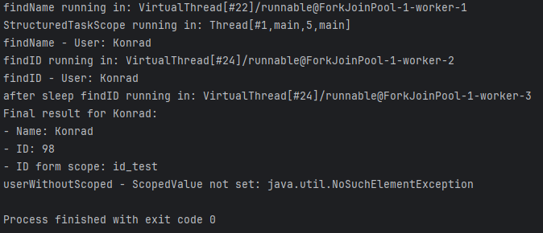
Structured Concurrency + Scoped Value

Slide 24
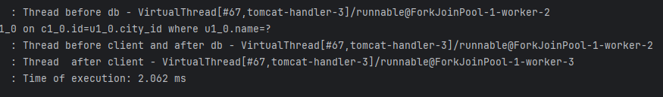
Virtual Threads + Spring Boot
To use Virtual Thread with spring boot you need add to properties spring.threads.virtual.enabled=true
This is not always true
An example of virtual threads used by Spring Boot is shown below (code on the next slide)

Slide 25
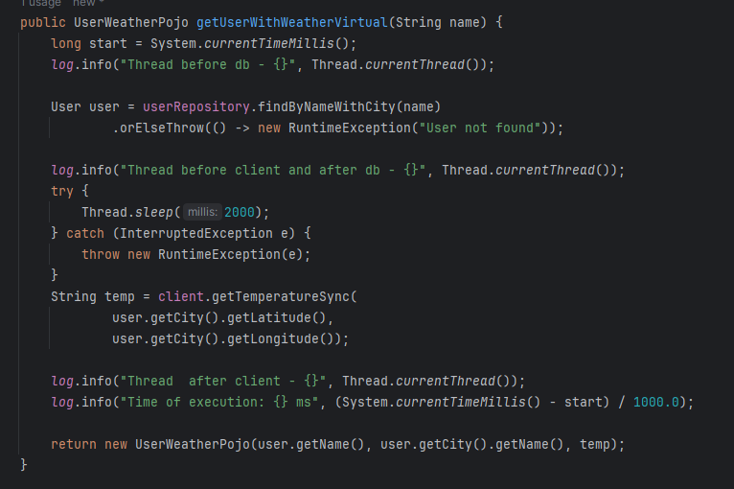
Virtual Threads + Spring Boot

Slide 26
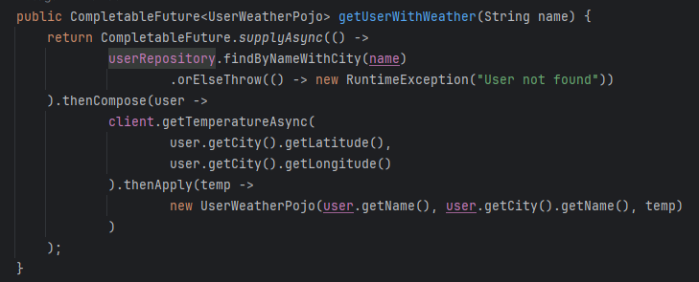
Code comparison (Completable Future )

Slide 27
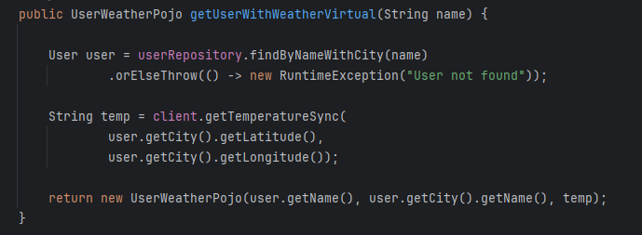
Code comparison (Virtual Threads)

Slide 28
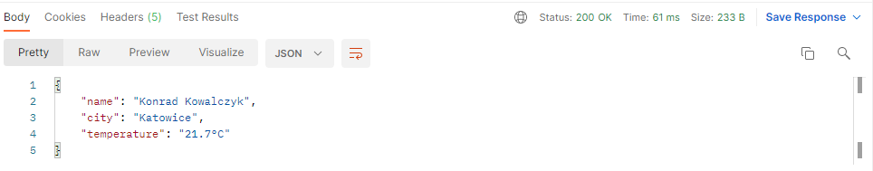
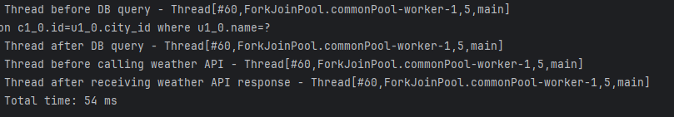
Completable Future
Results between 51 ms and 223 ms

Slide 29
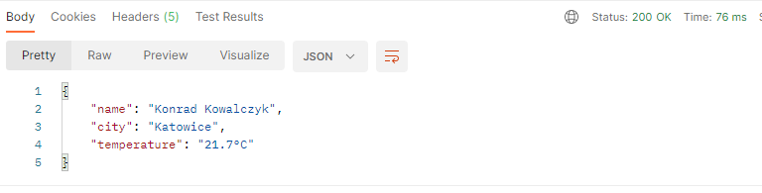
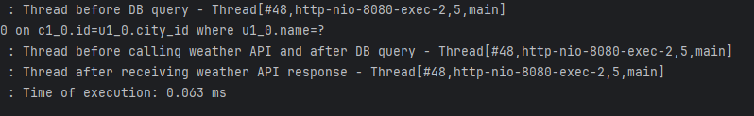
Blocking code
Results between 50 ms and 230 ms

Slide 30
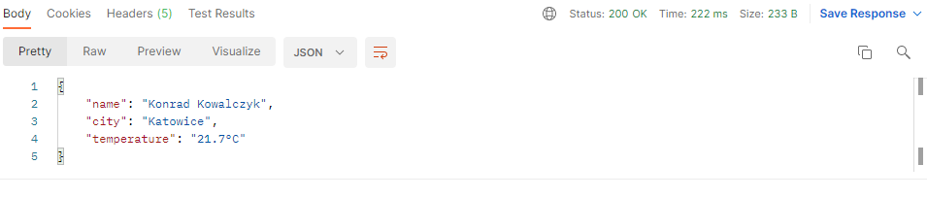
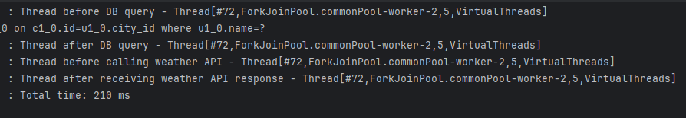
Completable Future + Virtual Threads
Results between 50 ms and 220 ms

Slide 31
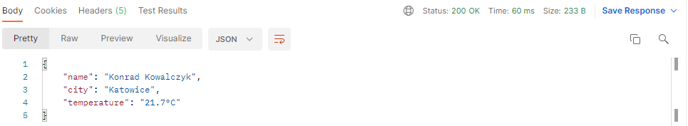
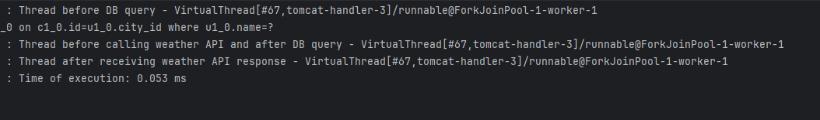
Blocking code + Virtual Threads
Results between 50 ms and 234ms

Slide 32
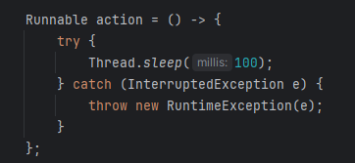
Completable Future <-> Virtual Threads
Both solutions, in different configurations, execute the same code repeated n times.
Task

Slide 33
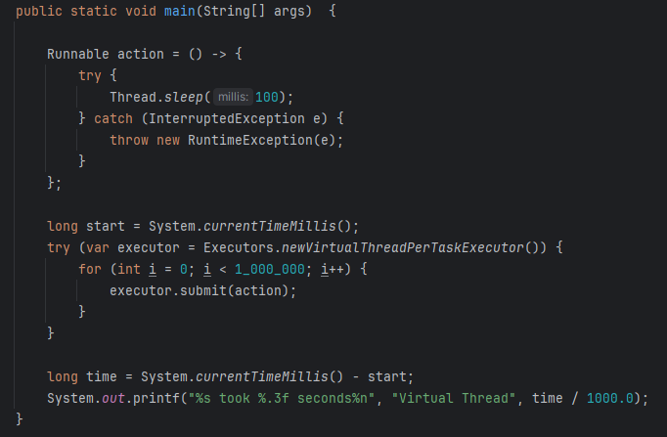
Virtual Threads
Example of solution
10 000 ->
50 000 ->
100 000 ->
200 000 ->
500 000 ->
1 000 000 ->

Slide 34
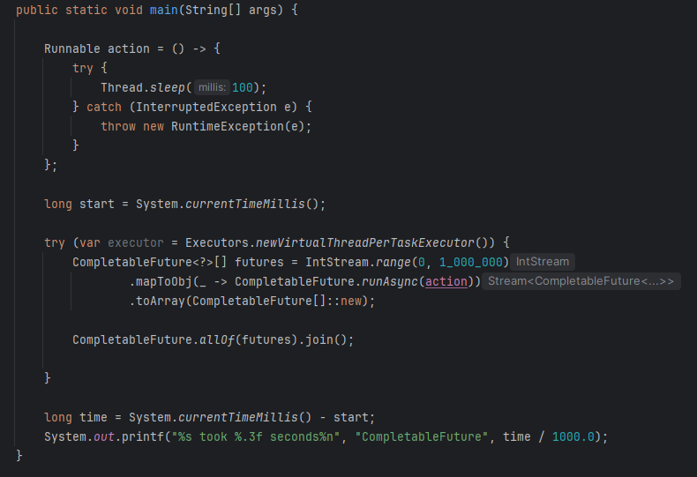
Completable Future + Virtual Executor
10 000 ->
50 000 ->
100 000 ->
200 000 ->
500 000 ->
1 000 000 ->

Slide 35
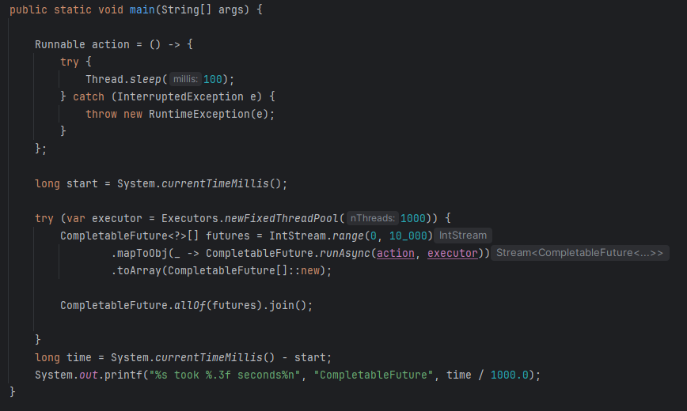
Completable Future + Platform Executor n = 1000
10 000 ->
50 000 ->
100 000 ->
200 000 ->
500 000 ->
1 000 000 ->

Slide 36
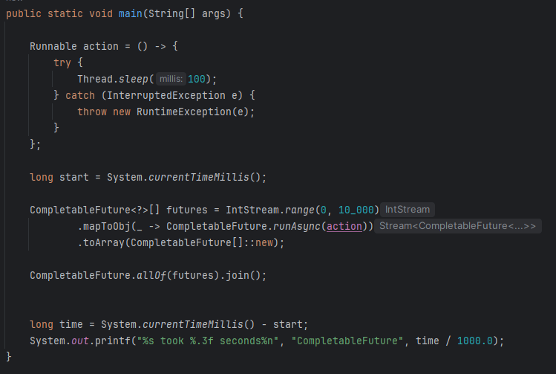
Completable Future + default ForkJoinPool
10 000

Slide 37

Summary
The Virtual Way won 🔥
On the Virtual Thread executor, both submit() and runAsync() methods showed comparable execution times. In contrast, running runAsync() on a platform thread executor with a pool size of 1000 was significantly slower.
This highlights that Virtual Threads provide much better performance and scalability for concurrent tasks compared to traditional Platform Threads.
Using ExecutorService.submit() with Virtual Threads:
simplifies code by avoiding complex callback management
reduces overhead from extra abstractions,
offers clearer control over task execution and synchronization.
Tests show that for large scale blocking tasks, direct use of Virtual Threads is often faster and simpler, making it a compelling choice for modern concurrent programming.

Slide 38
Spring Final Test (to ignore)
Running IntStream.range(0, 100000) with virtual threads caused minor database issues from too many connections. Virtual threads weren’t enabled by just adding properties—I had to configure the executor explicitly.

Slide 39



Spring Final Test (to ignore)
Without Virtual Threads
With Virtual Threads

Slide 40

Questions?
Thank you for your attention!
sources:
https://openjdk.org/
Presentation “Virtual Threads, 2 years later” by Adam Warski at the Devoxx conference
Presentation “Continuations: The magic behind virtual threads in Java” by Balkrishna Rawool at the Devoxx conference

